Slide 1
Model Selection
Noise Filtering part

Slide 2



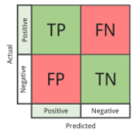
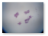


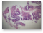
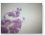

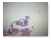
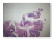




BUILT MODEL (59)
SELECTED MODEL (5)
QUALITATIVE-RANKED MODEL (5)
Notes:
Different pre-trained models (VGG16, Resnet, inceptionV3, Mobilenet)
Different Augmentation (Center Crop, Color Jitter, NaN)
Different training dataset (2020, 2020+2021)

Slide 3
1. SELECTING MODELS by NUMERIC PERF.
59
5
Model ID | Accuracy | TP | FN | FP | TN
M1 | 0.868715 | 214 | 62 | 32 | 408
M2 | 0.857541 | 206 | 70 | 32 | 408
M3 | 0.854748 | 252 | 24 | 80 | 360
M4 | 0.853351 | 255 | 21 | 84 | 356
M5 | 0.840782 | 224 | 52 | 62 | 378
. | . | . | . | . | .
.. | .. | .. | .. | .. | ..
... | ... | ... | ... | ... | ...
M59 | 0.617318 | 16 | 260 | 14 | 426
HIGHEST ACCURACY
LESS NOISE SAVED (LOWEST FP)
LESS NON-NOISE REMOVED (LOWEST FN)
MOST FAIRNESS

Slide 4
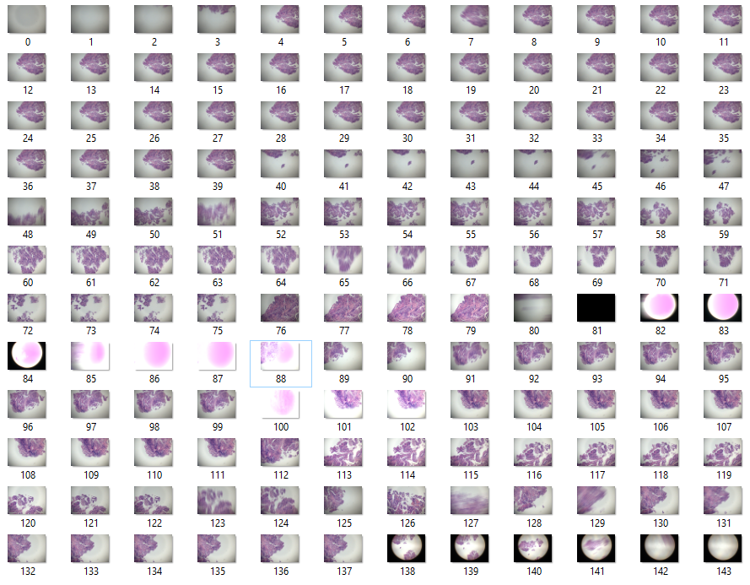
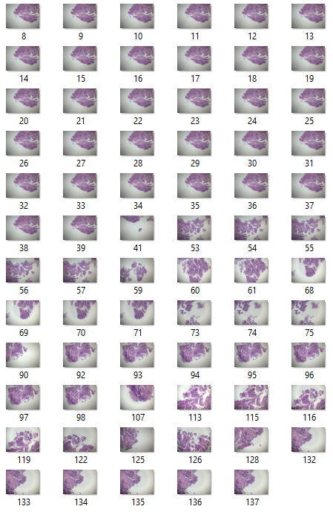
2. SELECTING MODELS by QUALITATIVE PERF.
5
5R
 | #images
GID | Orig. | M1 | ... | M5
1 | 36 | 32 | ... | 35
2 | 5 | 1 | ... | 3
3 | 9 | 5 | ... | 7
4 | 2 | 1 | ... | 1
5 | 12 | 6 | ... | 9
6 | 4 | 3 | ... | 4
7 | 4 | 0 | ... | 4
8 | 11 | 8 | ... | 10
9 | 11 | 1 | ... | 11
10 | 1 | 0 | ... | 1
11 | 12 | 5 | ... | 11
12 | 1 | 1 | ... | 1
13 | 1 | 1 | ... | 1
14 | 10 | 7 | ... | 8
15 | 2 | 0 | ... | 0
16 | 1 | 0 | ... | 0
ORIGINAL CAPTURED (144)
M1’S RESULT (71)
REPORT TABLE

Slide 5
2. SELECTING MODELS by QUALITATIVE PERF.
5
5R
REPORT TABLE
SUMMARY TABLE
 |  |  | #images
GID | B.R | E.R. | Orig. | M1 | ... | M5
1 | 4 | 39 | 36 | 32 | ... | 35
2 | 40 | 44 | 5 | 1 | ... | 3
3 | 49 | 57 | 9 | 5 | ... | 7
4 | 58 | 59 | 2 | 1 | ... | 1
5 | 60 | 71 | 12 | 6 | ... | 9
... | ... | ... | ... | ... | ... | ...
16 | 140 | 140 | 1 | 0 | ... | 0
 |  | #group found |  |  |  |  | #noise found
Slide | #group | M1 | M2 | M3 | M4 | M5 | M1 | M2 | M3 | M4 | M5
S1 | 51 | 48 | 46 | 49 | 51 | 48 | 4 | 9 | 32 | 25 | 23
S2 | 22 | 17 | 21 | 20 | 21 | 20 | 0 | 2 | 1 | 0 | 3
S3 | 117 | 88 | 97 | 105 | 109 | 110 | 1 | 24 | 20 | 12 | 61
S4 | 64 | 50 | 53 | 52 | 63 | 51 | 2 | 14 | 12 | 28 | 15
S5 | 95 | 82 | 90 | 84 | 90 | 92 | 1 | 21 | 6 | 10 | 39
The images, which are not in range, will be counted as noise.
Highest number of group found: M4 > M5 > M2 > M3 > M1
Least number of noise found: M1 > M4 > M3 > M2 > M5

Slide 6
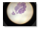

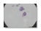


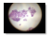


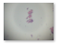
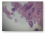
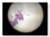



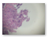
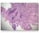
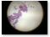

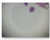
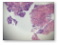




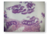





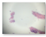


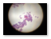



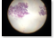
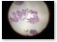
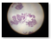
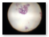
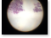
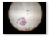
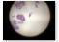
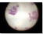
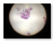
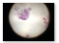
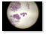
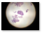
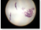
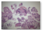
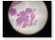
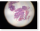
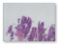










2. SELECTING MODELS by QUALITATIVE PERF.
5
5R
Model ID | Sample images from unfound groups | Finding
M1 |  | M1 cannot classified microscopic image if it... Is zoomed out (23/64) Is too much zoomed in (1/64) Is too bright (10/64) Contains space area more than cell area (11/64) Other (19/64)
S1: 3/51
S2: 5/22
S3: 29/117
S4: 14/64
S5: 13/95

Slide 7

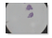
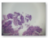
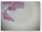
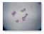

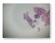
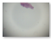






2. SELECTING MODELS by QUALITATIVE PERF.
5
5R
Model ID | Sample images from unfound groups | Finding
M2 |  | M2 cannot classified microscopic image if it... Is zoomed out (15/42) Is too bright (2/42) Contains space area more than cell area (18/42) Other (8/42)
S1: 5/51
S2: 1/22
S3: 20/117
S4: 11/64
S5: 5/95

Slide 8


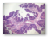
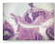



2. SELECTING MODELS by QUALITATIVE PERF.
5
5R
Model ID | Sample images from unfound groups | Finding
M3 |  | M3 cannot classified microscopic image if it... Is zoomed out (18/40) Is too bright (8/40) Contains space area more than cell area (7/40) Other (7/40)
S1: 3/51
S2: 2/22
S3: 12/117
S4: 12/64
S5: 11/95

Slide 9
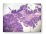
2. SELECTING MODELS by QUALITATIVE PERF.
5
5R
Model ID | Sample images from unfound groups | Finding
M4 |  | M4 cannot classified microscopic image if it... Contains space area more than cell area (5/15) Is too bright (3/15) Is too much zoomed in (1/15) Is zoomed out (1/15) Other (5/15)
S1: 0/51
S2: 1/22
S3: 8/117
S4: 1/64
S5: 5/95

Slide 10
2. SELECTING MODELS by QUALITATIVE PERF.
5
5R
Model ID | Sample images from unfound groups | Finding
M5 |  | M5 cannot classified microscopic image if it... Is zoomed out (23/28) Contains space area more than cell area (5/28)
S1: 3/51
S2: 2/22
S3: 7/117
S4: 13/64
S5: 3/95

Slide 11
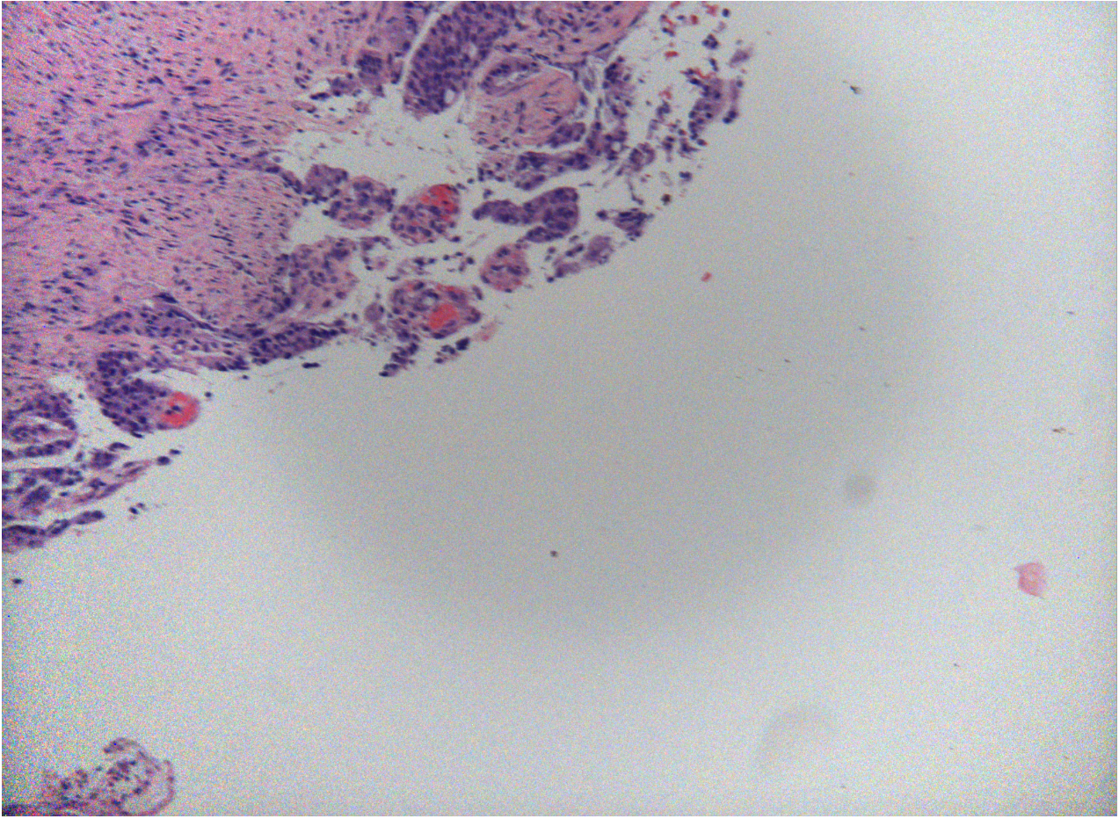
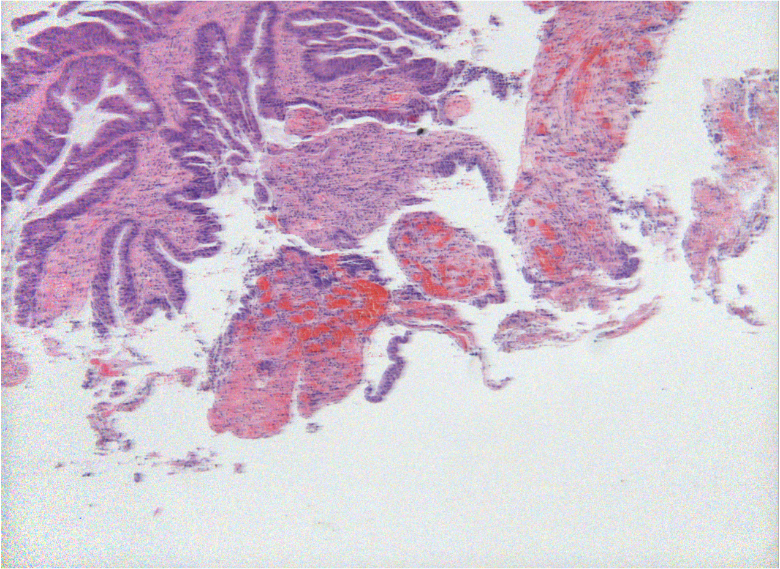

2. SELECTING MODELS by QUALITATIVE PERF.
5
5R
In progress
Qualitative performance in terms of misclassified noise images (~ 365 images to be considered)
Which kinds of noise are acceptable? Which are not?

Slide 12




2. SELECTING MODELS by QUALITATIVE PERF.
5
5R
In progress (2)
Is the grouping appropriate to use/consider?

Slide 13
THANK YOU
JJ

